Slide 1
Python Module

Slide 2
Python Module
Any text file with the .py extension containing Python code is basically a module. Different Python objects such as functions, classes, variables, constants, etc., defined in one module can be made available to an interpreter session or another Python script by using the import statement. Functions defined in built-in modules need to be imported before use.

Slide 3
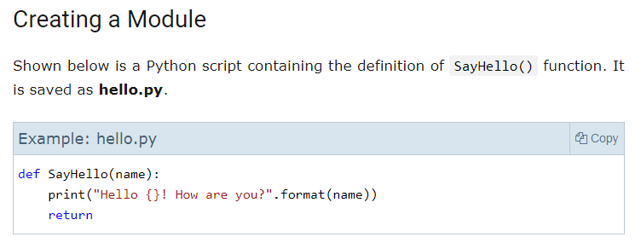
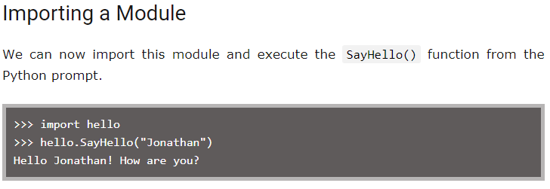

Slide 4
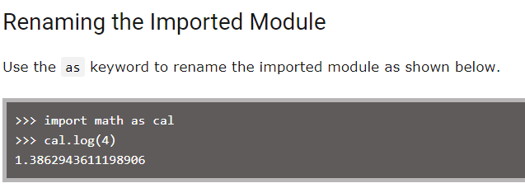

Slide 5
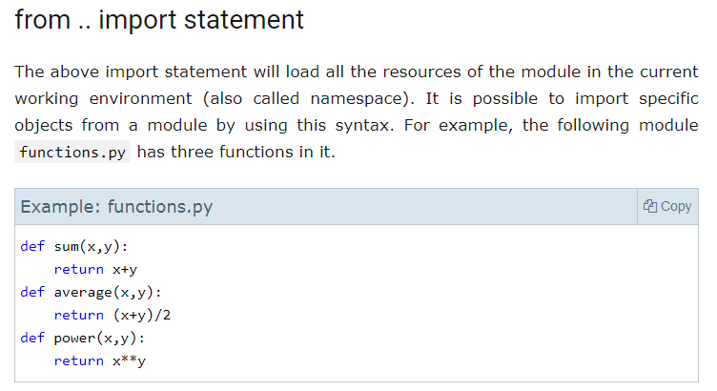

Slide 6
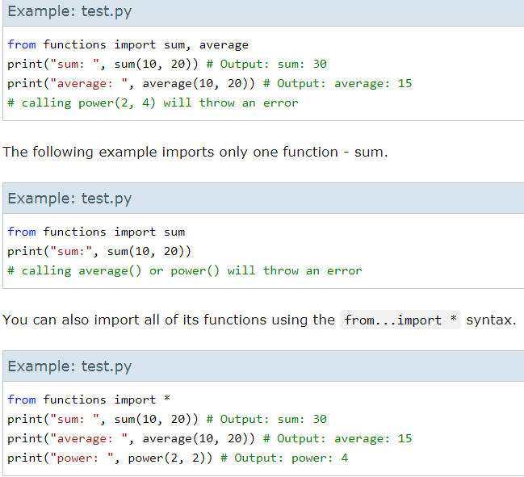

Slide 7
Practical programs for different modules – math,random,statistics

